Slide 1
Peer Perspective
Saurabh Singh

Slide 2

Education for the Young
Notes:
http://www.5minutesformom.com/wp-content/uploads/2013/11/student_doing_a_math_problem.jpg

Slide 3
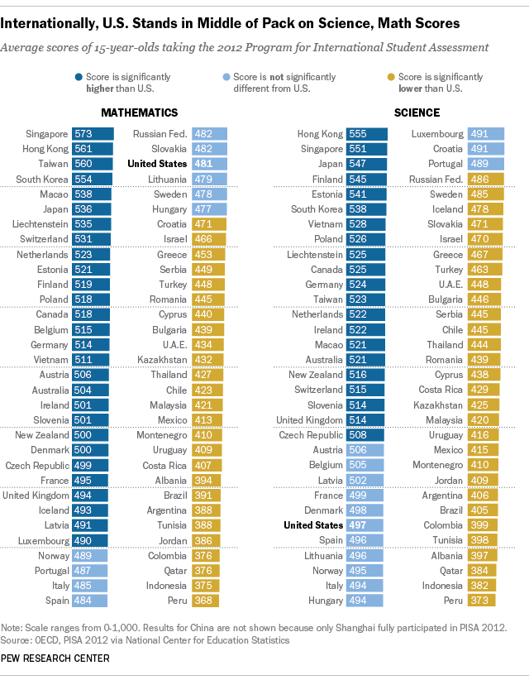
Education
Out of 64 countries the 15 year olds in the US are:
Ranked 35th in Math
Ranked 27th in Science.
Notes:
Good evening class, today I’m here to talk to you about an issue that has been prevalent in the past, present and will be in the future. (Pause) That issue is education. Out of 64 countries the US is ranked 35th in Math and 27th in Science. As you can see in the chart, 15 year old students in US are clearly struggling in math and science.

Slide 4



Resources for Students:
Internet (Google, Khan, etc)
Instructors
Textbooks

Slide 5
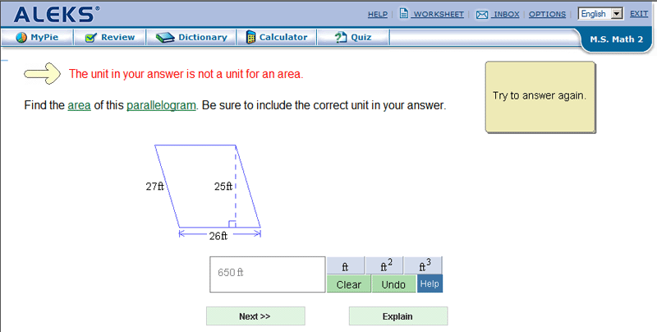
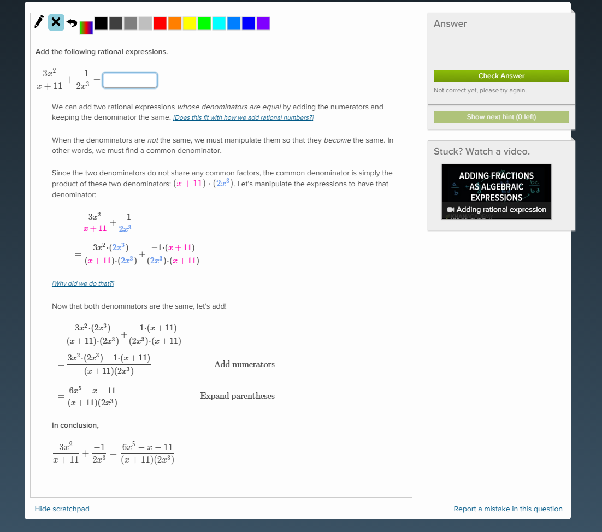
ALEKS
Khan Academy

Slide 6




PEP Tutor
1
2
3
Misconceptions
Randomly generated problem with misconception
Progression system with increasing difficulty

Slide 7
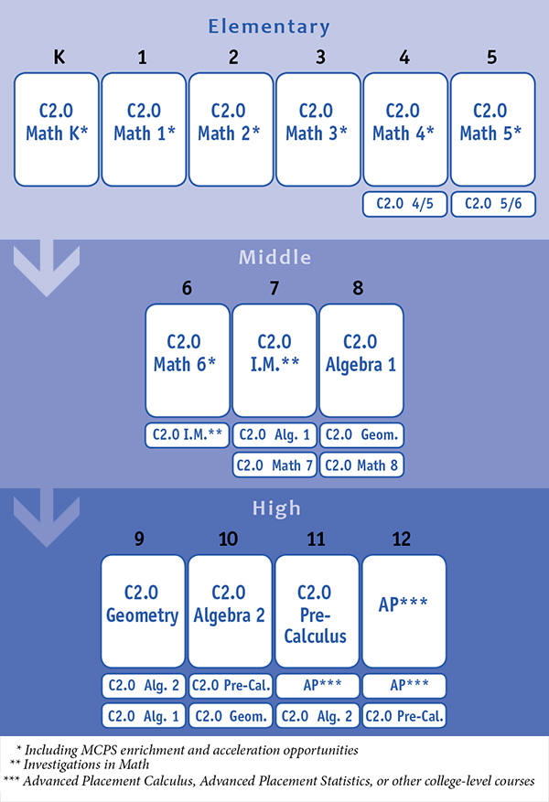

Slide 8
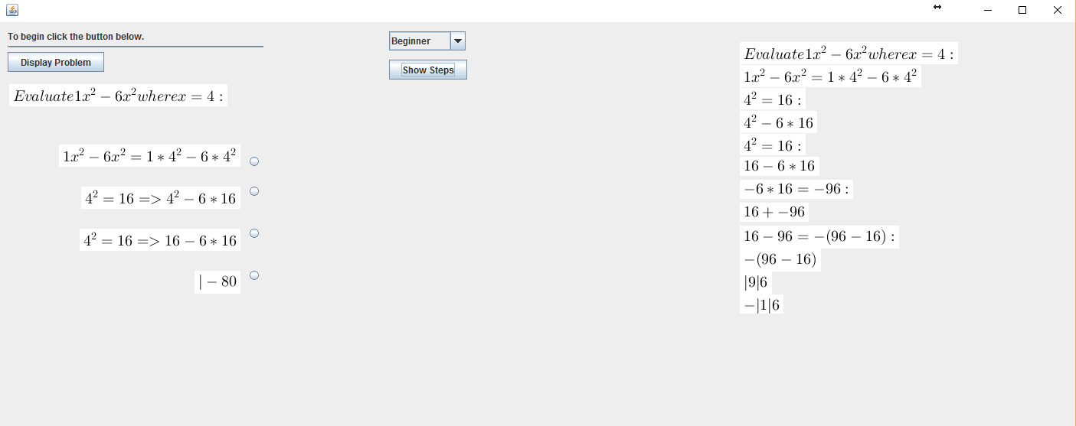

Slide 9
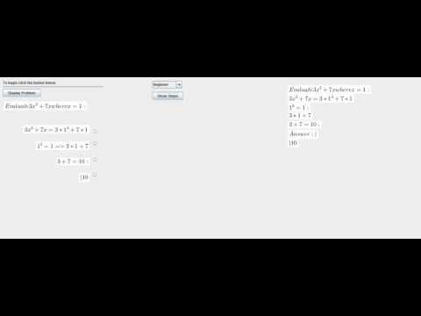
DEMO

Slide 10
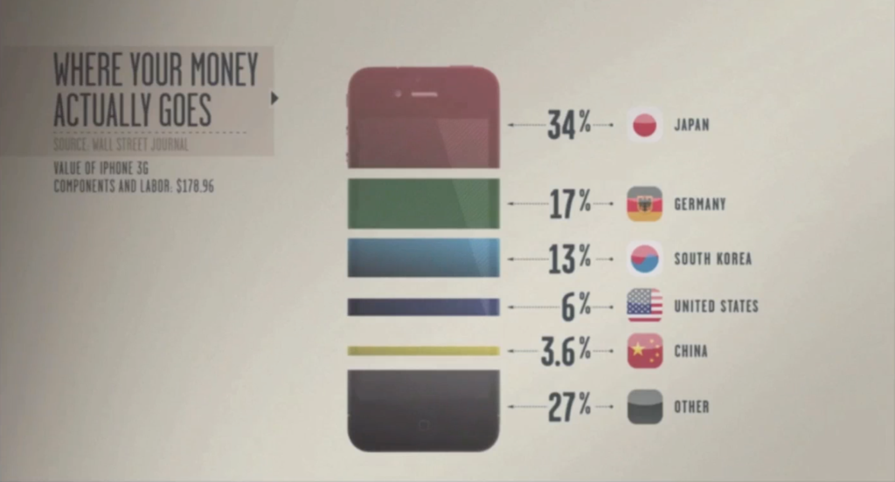
Working Force

Slide 11
CLOSING

